Slide 1

RUNGTA COLLEGE OF DENTAL SCIENCES & RESEARCH
TITLE OF THE TOPIC-
ORTHOPAEDIC APPLIANCE
DEPARTMENT OF ORTHODONTICS AND DENTOFACIAL ORTHOPAEDICS

Slide 2
Specific learning Objectives
CORE AREAS | DOMAIN | CATEGORY
DEFINITIONS | AFFECTIVE | DESIRE TO KNOW
BASICS | COGNITIVE | MUST KNOW
HEADGEAR | COGNITIVE | MUST KNOW
FACEMASK | COGNITIVE | MUST KNOW
CHIN CUP | COGNITIVE | MUST KNOW

Slide 3
Contents
PART I
Definitions
Basis Orthopaedic appliances
Headgear
PART II
Chin cup
Face mask

Slide 4
Orthopaedic Appliances
Definition
In orthodontic practice forces employed are of two types :
1.Orthodontic force
2.Orthopaedic force
Orthodontic forces are those that are applied by means of wires and other active components of rermovable and fixed appliances.
Orthopaedic forces are heavy forces over 400 gms that bring about a change in skeletal tissue.

Slide 5
Basis for orthopaedic appliances
In order to produce skeletal changes consideration should be given to the amount of force applied and duration of force .
Amount of force .
Heavy forces of over 400 gms totally compress the periodontal ligament on the pressuren side and cause hyalinization that prevents tooth movement .These heavy forces are conducted to the skeletal structures to produce an orthopaedic effect.

Slide 6
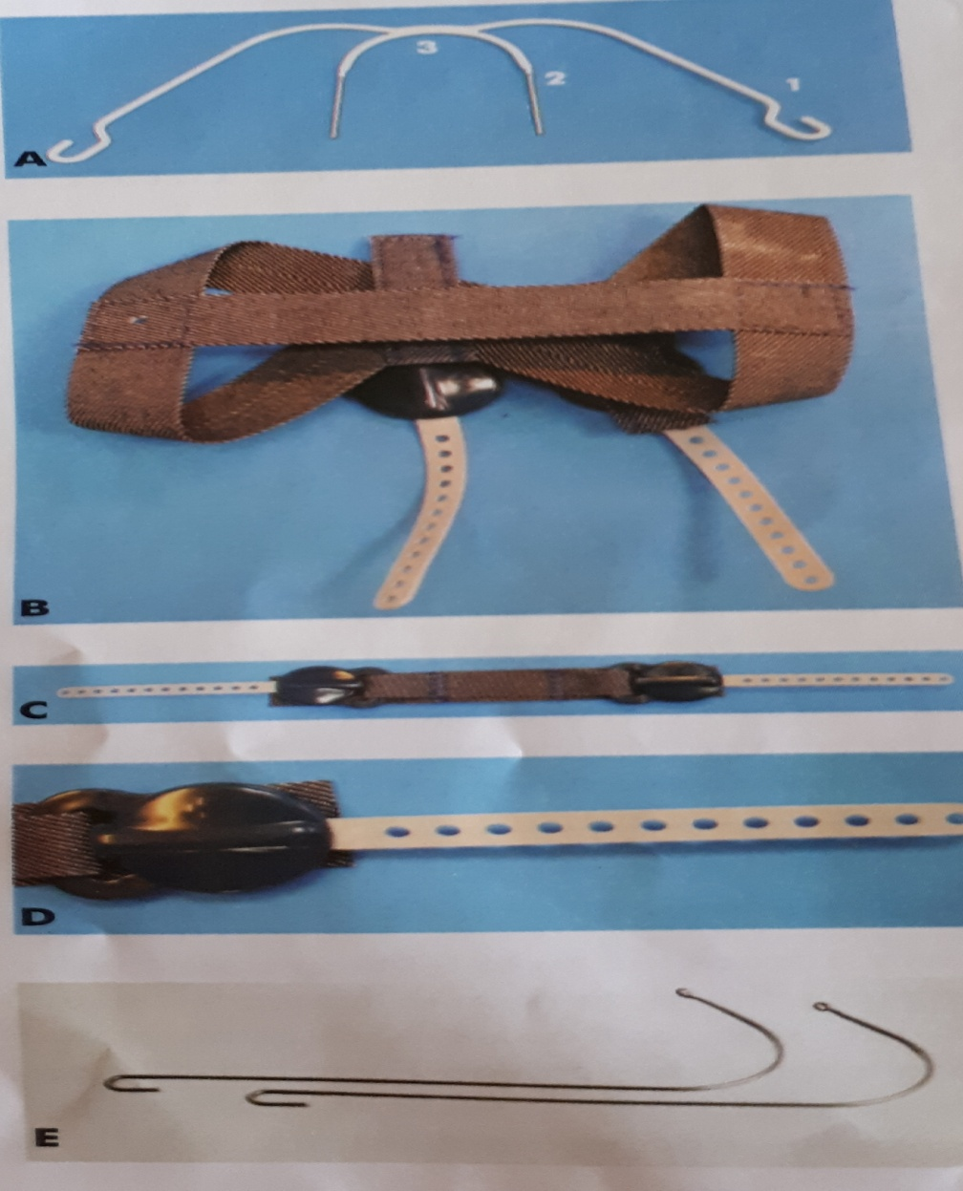
A. FACEBOW 1.OUTER BOW
2 .INNER BOW
3.JUNCTION
B. HEAD CAP
C . CERVICAL STRAP
D. FORCE ELEMENT
E. THE J HOOK TYPE

Slide 7
Duration of force
Intermittent forces ranging from 12-14 hours a day are believed to bring about minimum tooth movement but maximum skeletal changes .Thus most extraoral orthopaedic appliances worn 12-14 hours a day.
Head gears
Head gears are the most commonly used extraoral orthopaedic appliances .They are used during the growth period to intercept or correct certain skeletal malocclusions as well as to distalize the maxillary dention or maxilla.

Slide 8
The headgear –facebow assembly has 3 components.
1.Facebow
2.The force element
3.The head cap.
Facebow
There are 2 types of facebow that are used in orthodontics.
Inner outer bow type &j hook type facebows .

Slide 9
Inner outer bow type
Facebow is a metallic component that helps in tansmitting extraoral forces on to the posterior teeth .The facebow consist of outer bow , inner bow and junction.
The outer bow can be short , medium or long.
1.Short- Outer bow is leeser in length than inner bow.
2.Medium- Outer bow length is equal to inner bow.
3.Long- outer bow is longer than inner bow.

Slide 10
The distal end of the outer bow is curved to form a hook that gives attachment to the force element .
The inner bow is made of 1.25mm round stainless steel wire and contoured around the dental arch and molars. Inner bow is inserted into the buccal tubes fixed on the maxillary first molars.
J hook type of facebow.
These type of facebow consists of two 0.072 inch curved wires whose ends form hooks that are contoured to fit over a small soldered stop on the anterior segment of the maxillary arch wire .

Slide 11
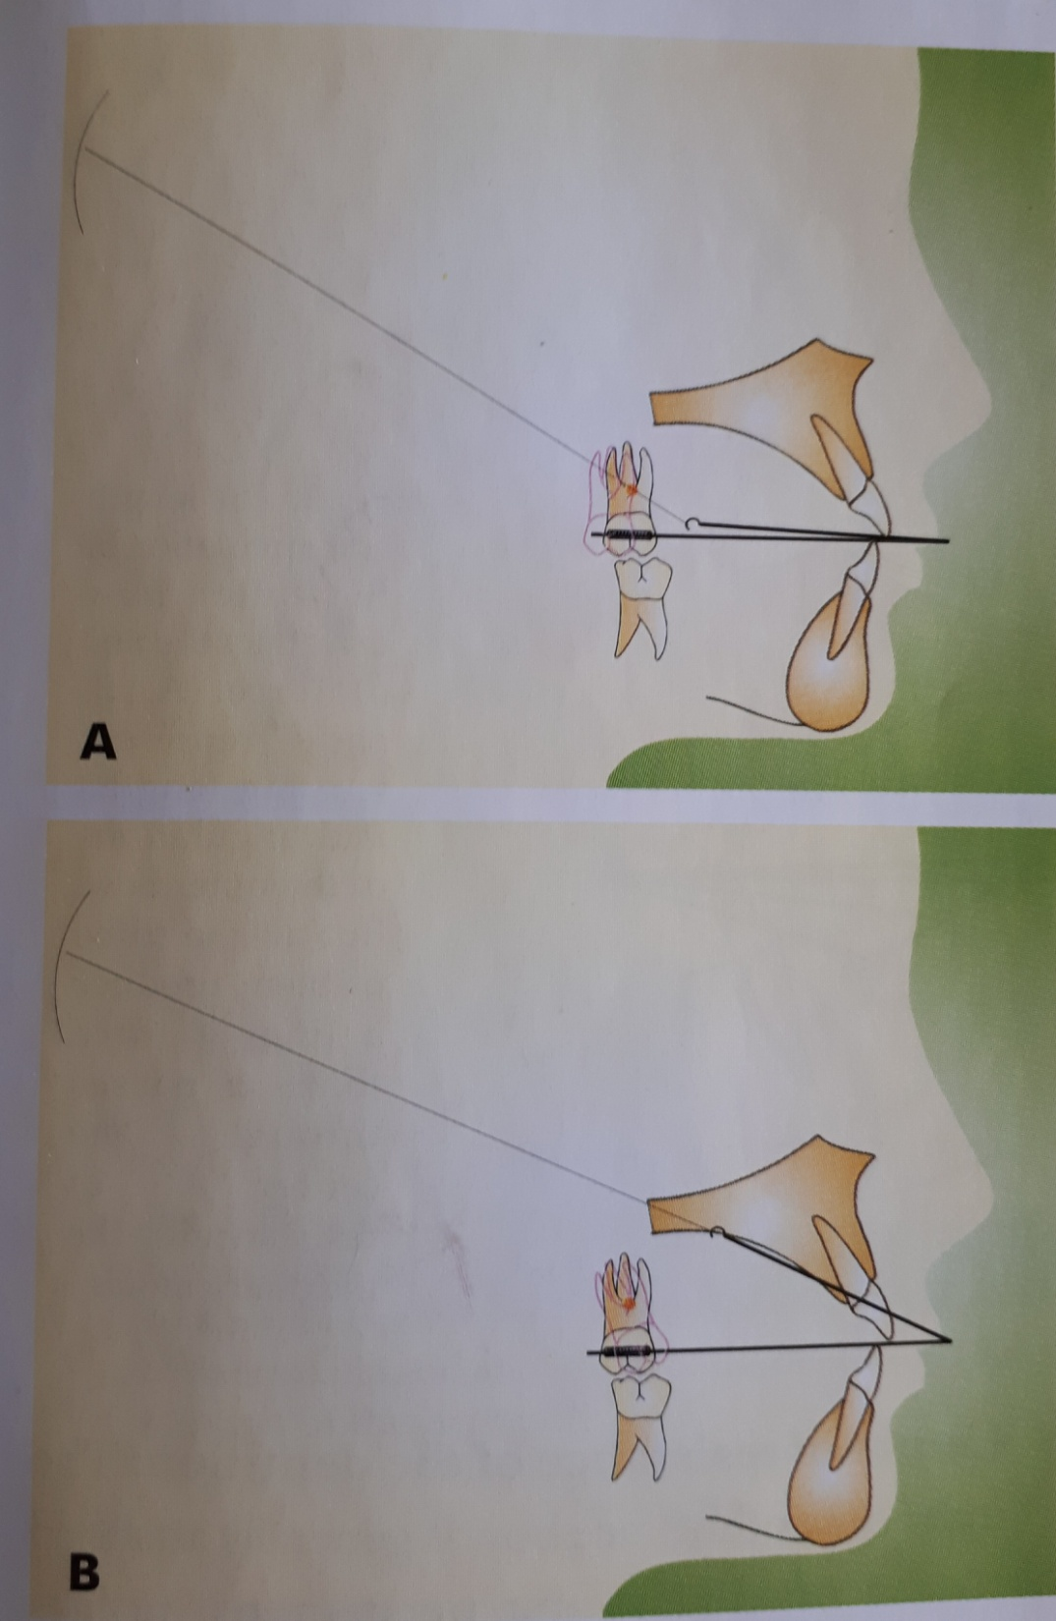
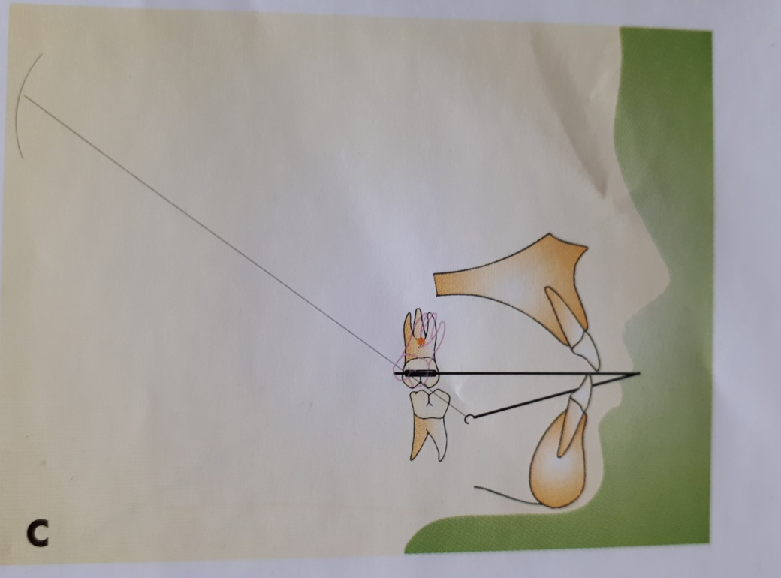
This line of force causes bodily movement of molar
This line of force causes distal root tipping of molar
Line of force causes distal crown tipping.

Slide 12
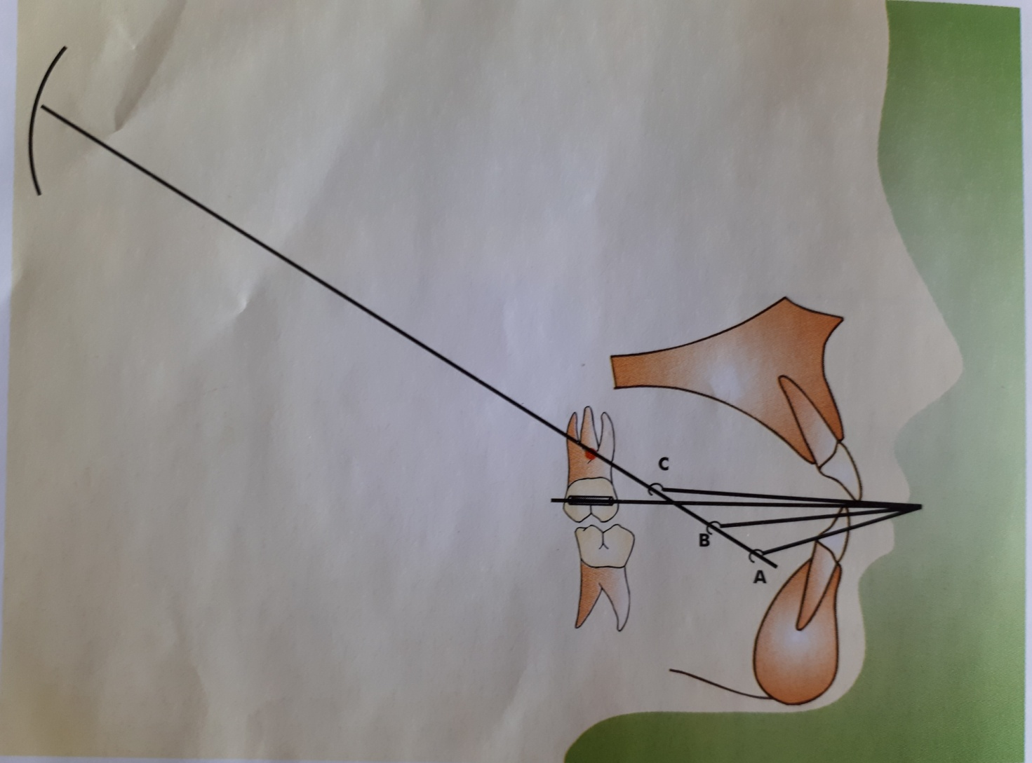

Slide 13
Their normal site of attachment on the arch wire in between lateral incisor and canine .
The force element
It is that part of assembly which provides the force to bring about the desired effect .
These may comprise of springs ,elastics and other stretchable materials .
The headcap or cervical strap
The appliance takes anchoragve from the rigid bones of the skull from the back of the skull or from the back of the neck by means of head cap or neck strap or a combination of the two.

Slide 14
Principles in the use of headgears
Headgears have the ability to move the dentition and the maxilla in all the 3 planes of space .
Following factors should be considered .
Centre of resisistance of the dentition :
The inner bow of the facebow is generally attached to the maxillary first permanent molars through buccal tubes on these teeth.Thus the force acting on the molars tends to displaced them .A decision should be made as to whether bodily movement or tipping of the teeth is required .

Slide 15
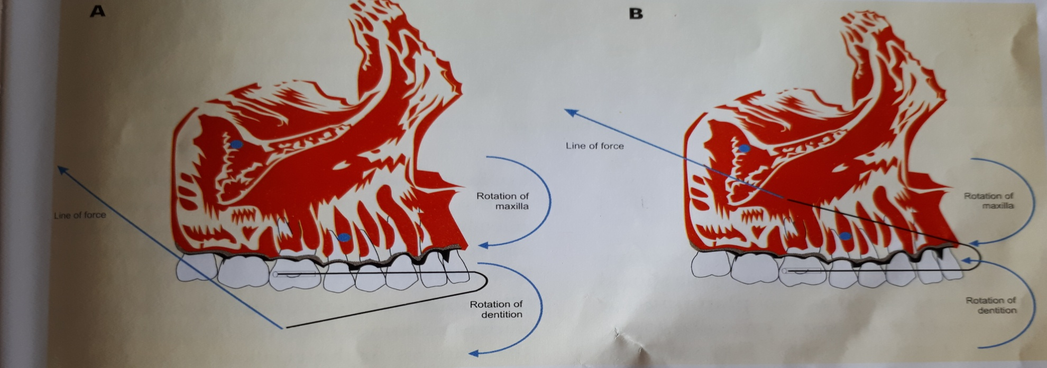
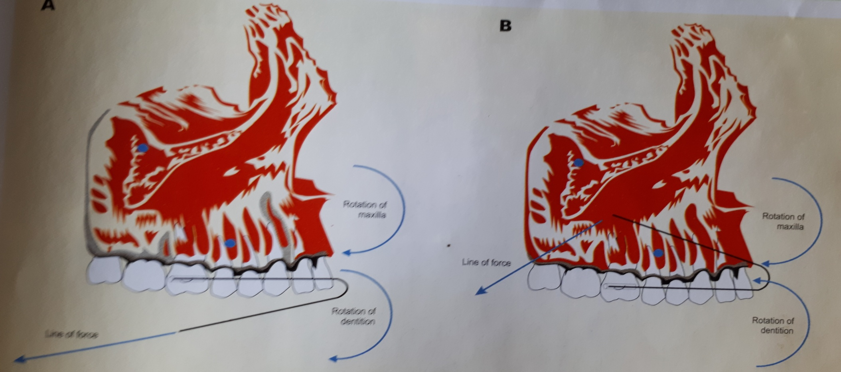

Slide 16
The centre of resistance for a molar is usually at the mid tooth region .Forces applied through the centre of resistance of the molars results in their bodily movement .
Centre of resistance of maxilla.
The centre of resistance of the maxilla as a whole should also be considered when planning for headgears. It is believed to exist at the posterosuperior aspect of zygomaticomaxillary suture. Forces passing through the centre of resistance of the maxilla produce translation of the maxilla in a distal direction while forces passing above or below this point cause rotationh of the maxilla.

Slide 17
The point of origin of the force :
Headgears derive anchorage from the occipital region of the cranium or the cervical region .occipital headgears produce a superior and distal force on the teeth and maxilla while cervical headgears produce an inferior and distal force on the teethand maxilla .
Point of attachment of force .
The point of attachment refers to the hook present on the distal end of the outer bow to whch the force element is attached

Slide 18
Types of headgears
Based on the site of anchorage headgears can be of :
Cervical Headgears
2. Occipital headgears
3 . Combination headgears
4. Vertical pull headgears
5. Assymetrical Headgears.

Slide 19
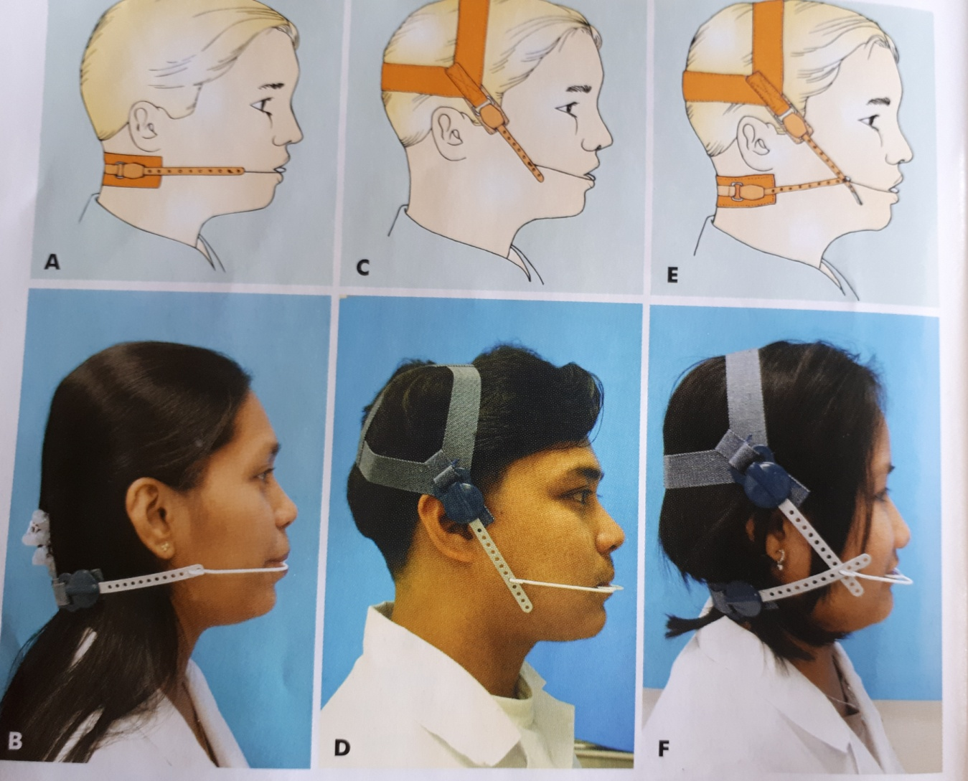
A &B cervical headgear
C&D occipital headgear
E&F combination headgear

Slide 20
Cervical headgears
These headgears obtain anchorage from the nape of the neck .Cervical headgears cause extrusion of the maxillary molars leading to increase in the lower facial height.They also move the maxillary dentition and the maxilla in adistal direction .These headgears are generally indicated in low mandibular angle cases , as an increase in lower facial height would be beneficial in such patients.
Occipital headgears
These headgears derives anchorage from the back of the head .This type of headgear produces a distal and superiorly directed force on the maxillary teeth and maxilla.These high pull headgears produce a more vertically directed forceand therefore is used in individuals in whom an increase in vertical dimension is to be avoided.

Slide 21
Combination headgears
In this type of headgear occipital and cervical anchorage is combined .When the forces exerted by tooth are equal a distal and slight upward force is exerted on the maxillary dentition and the maxilla.
Vertical pull headgears
They are headgears that derive anchorage from the parietal region of the cranium and therefore produce a vertically directed force on the maxilla and maxillary dentition . These headgears can be used to produce intrusive forces on the anterior region of maxilla thereby producing a counter clockwise moment of the maxilla.

Slide 22
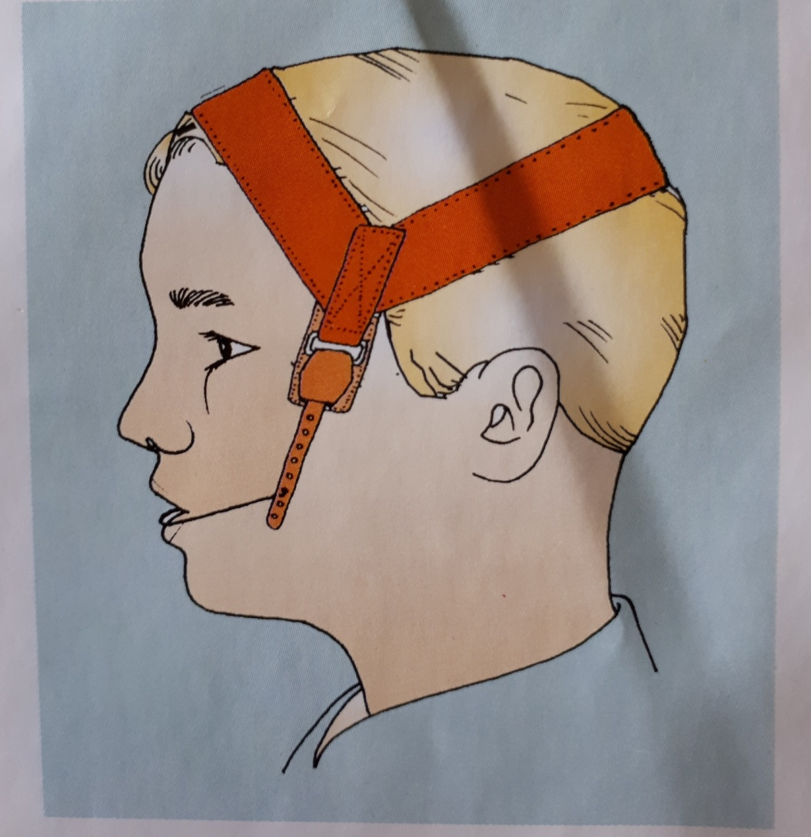
Vertical pull headgear

Slide 23
Assymetrical headgears
They are used when differential anchorage is required on both sides of maxillary arch .
Uses of headgears
1.Orthopaedic effect: Forces applied on to the maxilla can be used to restrict its downward and forward growth.The distal force in such a case should be applied through the centre of resistance of the maxilla
2.Anchorage augmentation: Extraoral forces are used to reinforce anchorage when those obtained from intraoral sources are insufficient.

Slide 24
3.Distalization of molars: Distal movement of upper molars maybe required for correction of molar relation or to gain space for correction of crowding or retraction of anteriors.
4.Space maintenance: A most effective method of maintaining arch length by use of extraoral forces
5.Molar relation : In order to derotate molar the molar has to be banded with the buccal tube placed distally and then subsequently repositioned .

Slide 25
SUMMARY
Extraoral traction devices are those that utilize anchorage outside the oral cavity for efficient application of force in direction not otherwise possible.
These appliances are capable of producing orthodontic and
orthopedic effects.
Anchorage obtained outside the oral cavity can be based on different areas as follows:
• Cervical: Utilizing neck for anchorage (e.g. neck straps)
• Occipital: Utilizing the occipital region for anchorage
(e.g. headgears)
• Cranial: Involving the cranium as a source of anchorage (e.g. high-pull headgears)
• Facial: Involving aspects of the face as a source of anchorage (e.g. face masks)

Slide 26
REFERENCES
Textbook of Orthodontics – Gurkeerat Singh, Jaypee Brothers; 2nd Edition
Orthodontics – The Art and Science, S.I Bhalajhi, AryaMedi Publishing; 7th Edition
Textbook of Orthodontics – Sridhar Premkumar, Elsevier; 1st Edition
Orthodontics: Diagnosis and Management of Malocclusion and Dentofacial Deformities – O.P Kharbanda, Elsevier; 1st Edition

Slide 27
Question & Answer Session

